Slide 1
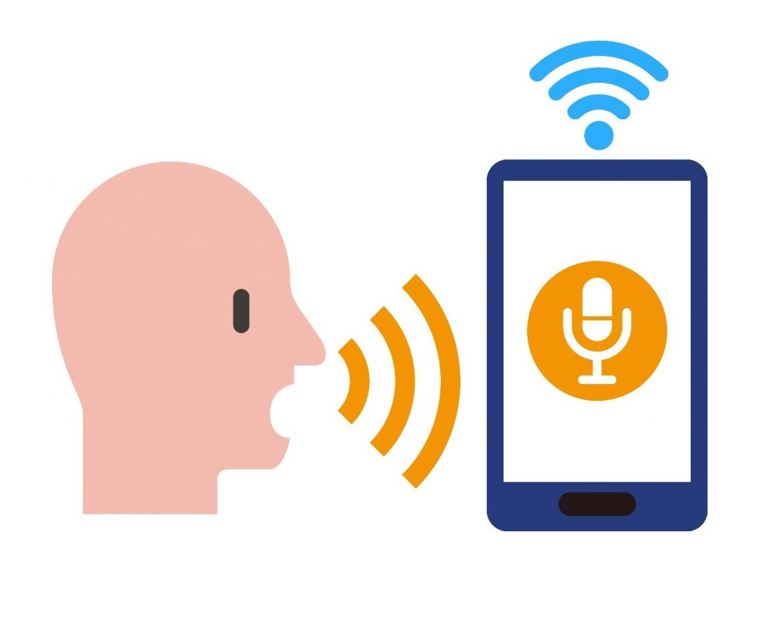
Smart Phone Based Authentication
Alexia Jackson, Jarel Ross, Dazhia Blassingame

Slide 2
Objective
Educate users on the importance of keeping their smartphones secure.
Research how voice recognition is currently being used and how effective it is.
Investigate fingerprint, passwords, facial recognition, and voice recognition and which one is the most effective and efficient and how those practices can be used alongside voice recognition to improve the authentication process.

Slide 3
Motivation
Artificial intelligence was one of my many fascinations in computer science because i was always intrigued on how a machine can understand and interact with a human being.
Communication with technological devices and gadgets by voice has become so people and normalized to the point where I wonder why many high profile companies are revealing their services to us now.

Slide 4

Motivation

Slide 5
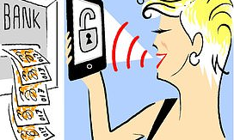
Findings/Observations
Many banks are switching to voice recognition on their mobile app as a secure form of logging into your account to view information.
Voice recognition, a form of biometric software, is a more secure form of banking protection because our voices are unique. Each voice has a set of around 100 characteristics.
Half of those are physical characteristics such as the shape of the mouth and throat as well as behavioral characteristics such as sound and words used.
Once an individual’s unique ‘voice print’ has been captured, further banking calls will be matched against it.
The system cannot be cheated by mimicking a voice, and will recognize the voice even if you are quiet,have a cold or are in a loud office.

Slide 6
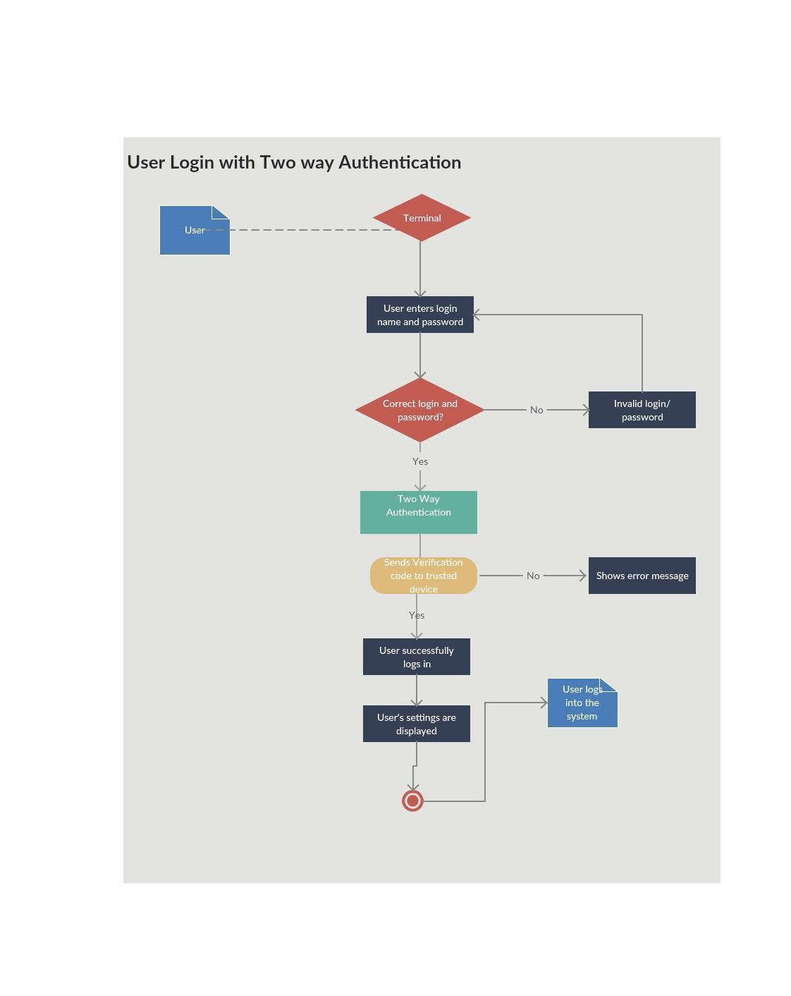
How Authentication Works

Slide 7

Future Work Plan
&
Conclusion
We are still some good distance from understanding the genuine capability of speech recognition technology. This applies both to the modern day teachings as well as innovations of technology and to its combination into our lives.
The current speech recognition technology can translate and interpret speech very fluently already, yet they are not the conversational interfaces that the a.i developers need them to be.
Additionally, speech recognition remains restricted to a small number of products and features.
The pace of progress, contrasted with the soonest attacks into speech recognition along with a.i has exceeded its expectations
The future of voice recognition is looking bright.
Given its current usage both in the home and on the move, it seems as though this technology will only get bigger over the next few years.

